Slide 1
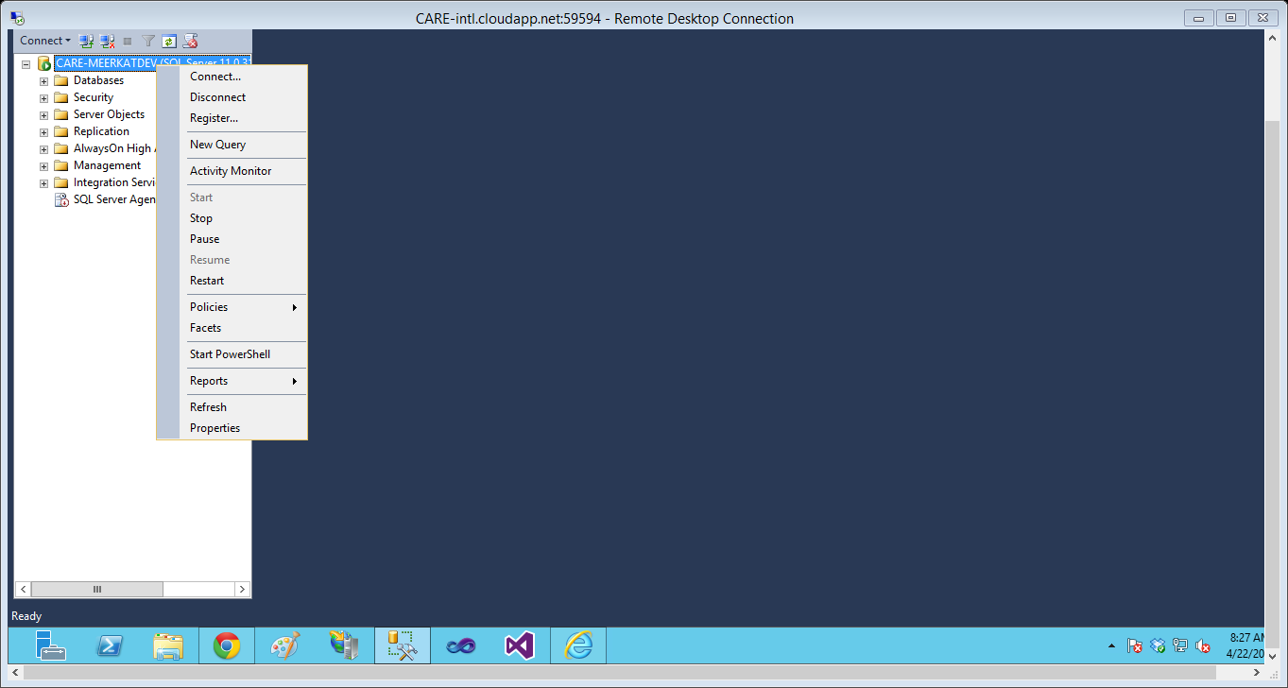
Right click on the database engine instance and click on properties.
Notes:
Right click on the database engine instance and click on properties.

Slide 2
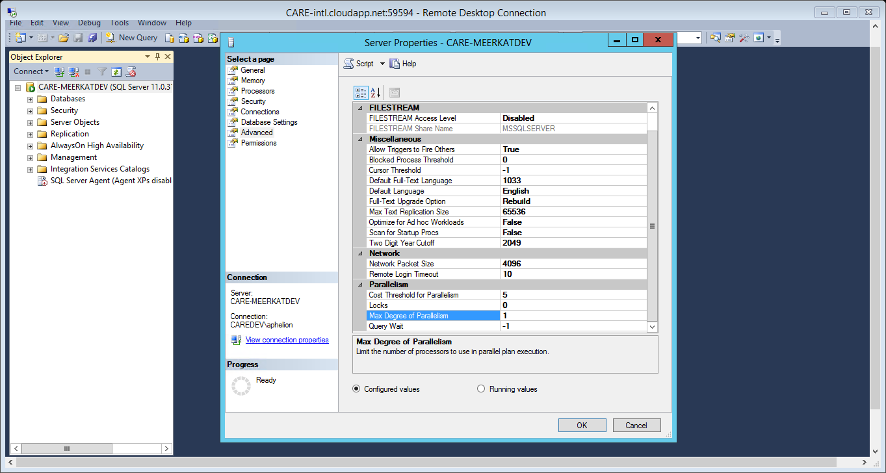
From the resultant dialog, click on “Advanced” then look for “Max Degree of Parallelism” and set the value to “1”.
Notes:
From the resultant dialog, click on “Advanced” then look for “Max Degree of Parallelism” and set the value to “1”.

